Slide 1


Slide 2
Beyond thinking
1.Bharath g.v
2.Prabhat kumar pani
3.Giridhar br
4.Syed Shoaib abrar

Slide 3
Problem statement- library management

Slide 4
Library management
Library management in uipath studiox provides a centralized repository for storing and managing reusable automation assets, such as workflows, activities, variables, and custom functions. These assets can be created by the user or shared by other team members, fostering collaboration and promoting the reuse of automation logic across projects and processes.
The library acts as a container for these assets, making them easily accessible and shareable within the organization. Users can create new libraries, categorize them based on the type of automation components, and define access permissions to ensure proper governance.

Slide 5
Within each library, users can create, edit, and version control individual automation components.
* This allows for iterative development and refinement of automation logic while maintaining a history of changes.
* The version control feature enables users to track modifications, compare different versions, and revert to previous iterations if needed.
Library management also provides search and filtering capabilities, making it effortless to locate specific automation assets. Users can explore the available libraries, search by keywords, and apply filters based on tags, types, or creation dates.

Slide 6
This feature streamlines the discovery and reuse of existing automation components, reducing redundancy and saving time.
Furthermore, library management supports seamless integration with uipath's automation hub and orchestrator, uipath's centralized automation platform. Users can publish libraries to automation hub, making them available to a wider audience and facilitating enterprise-wide automation governance. Libraries can also be deployed and executed from uipath orchestrator, allowing for scalable and orchestrated automation across multiple machines and environments.
Overall, uipath studiox's library management feature empowers non-technical users to organize, reuse, and collaborate on automation components effectively. By providing a structured and centralized repository, version control, search capabilities, and integration with other uipath products, it enhances productivity, accelerates automation development, and promotes collaboration in organizations embracing the power of automation.

Slide 7
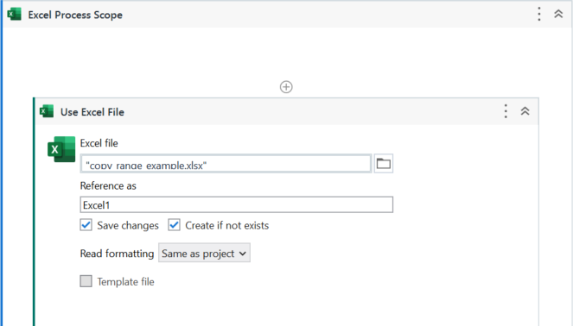
Library Usecase

Slide 8
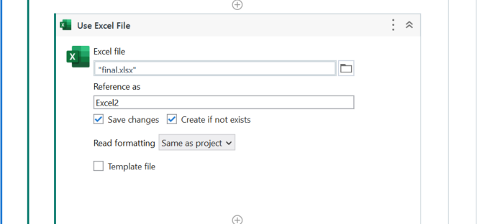

Slide 9
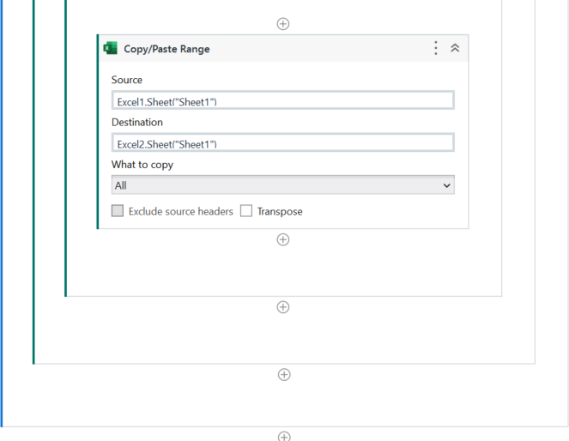

Slide 10
ADVANTAGES
Collaboration and teamwork: library management facilitates collaboration among team members. Automation assets can be shared within the organization, allowing team members to leverage each other's work. It promotes knowledge sharing, fosters a standardized approach to automation, and encourages teamwork by enabling multiple users to contribute to and benefit from the shared library of automation components.
Consistency and standardization: library management helps enforce consistency and standardization across automation projects. By storing reusable components in a central repository, users can ensure that all workflows within the organization adhere to predefined standards and best practices. This improves the maintainability of automation solutions and facilitates the management of updates or changes.
Version control and history tracking: library management enables version control, allowing users to track changes made to automation components over time. This feature provides a history of modifications, facilitates collaboration, and supports the ability to revert to previous versions if necessary. It ensures transparency and accountability in automation development and maintenance.
Easy discovery and accessibility: library management offers search and filtering capabilities, making it effortless to find and access specific automation components. Users can explore libraries, search by keywords, and apply filters to locate the desired assets quickly. This promotes the discoverability and accessibility of automation components, leading to increased productivity and reduced duplication of effort.
Integration with automation hub and orchestrator: library management integrates seamlessly with uipath's automation hub and orchestrator. Libraries can be published to automation hub, enabling wider accessibility and governance across the organization. Libraries can also be deployed and executed from orchestrator, allowing for scalable and orchestrated automation across multiple machines and environments.
Reusability and efficiency: library management promotes the reuse of automation components. Instead of recreating the same logic or activities for each workflow, users can store and share them in libraries. This leads to increased efficiency, as users can easily access and incorporate existing components into new projects, reducing development time and effort.

Slide 11
Features
Centralized repository: library management provides a centralized location for storing and managing automation assets. Users can create libraries to categorize and organize their components effectively, making them easily accessible to authorized users.
Reusability: automation components stored in libraries can be reused across different projects or workflows. This promotes efficiency by eliminating the need to recreate the same logic or activities repeatedly. Users can leverage existing components, saving time and effort in development.
Collaboration and sharing: libraries enable collaboration among team members. Users can share libraries with colleagues, allowing them to access and benefit from the stored automation components. This fosters teamwork, knowledge sharing, and a consistent approach to automation development.

Slide 12
Thank you

